Slide 1

REQUIREMENTS ELICITATION TECHNIQUES

Slide 2



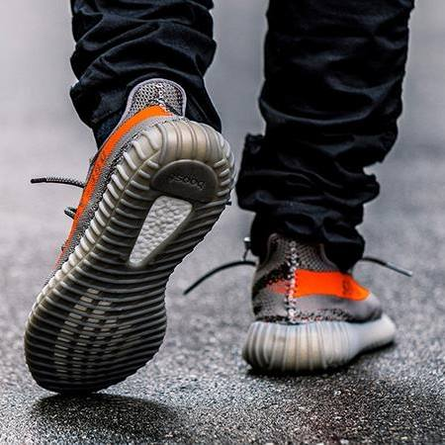


GROUP MEMBERS
Quốc Thịnh
Hoàng Tuấn
Trung Kiên
Việt Cường
Minh Thư
Văn Đại

Slide 3





Our Timeline
User interface analysis
01
02
Document analysis
Brainstorming
03
04
Prototyping
05
Summary

Slide 4
USER INTERFACE ANALYSIS

Slide 5
Prototyping is building user interface without adding detail functionality for user to interpret the features of intended software product
Defined
User interface (UI) analysis is an independent elicitation technique in which you study existing systems to discover user and functional requirements .
USER INTERFACE ANALYSIS

Slide 6

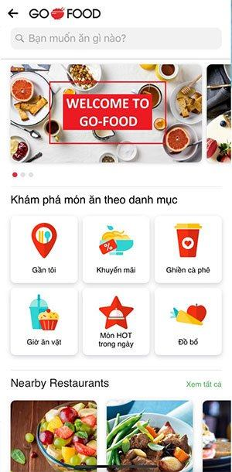

Slide 7
Prototyping is building user interface without adding detail functionality for user to interpret the features of intended software product
Used for
UI analysis can help you identify a complete list of screens to help you discover potential features.
USER INTERFACE ANALYSIS

Slide 8

Prototyping is building user interface without adding detail functionality for user to interpret the features of intended software product
Advantages
USER INTERFACE ANALYSIS

Slide 9
DOCUMENT ANALYSIS

Slide 10
DOCUMENT ANALYSIS

Slide 11
Prototyping is building user interface without adding detail functionality for user to interpret the features of intended software product
Defined
Document analysis is requirements elicitation techniques or evaluating documents—both printed and electronic material. Like other analytical methods in qualitative research, document analysis requires that data be examined and interpreted in order to elicit meaning, gain understanding, and develop empirical knowledge
DOCUMENT ANALYSIS

Slide 12
Prototyping is building user interface without adding detail functionality for user to interpret the features of intended software product
Three stages of document analysis
Prepare Stage
Review Stage
Wrap up Stage
DOCUMENT ANALYSIS

Slide 13
Prototyping is building user interface without adding detail functionality for user to interpret the features of intended software product
Useful document
Forms: This will tell you a lot about the process! It will help you to understand the data that’s collected, and it might even hint at the business rules that apply
business processes
User manuals for existing or similar applications
Documents can describe corporate or industry standards
DOCUMENT ANALYSIS

Slide 14
Prototyping is building user interface without adding detail functionality for user to interpret the features of intended software product
Useful document
Previous requirements documents
Comparative reviews
Problem reports and enhancement requests collected from users
Product/service promotional material
DOCUMENT ANALYSIS

Slide 15
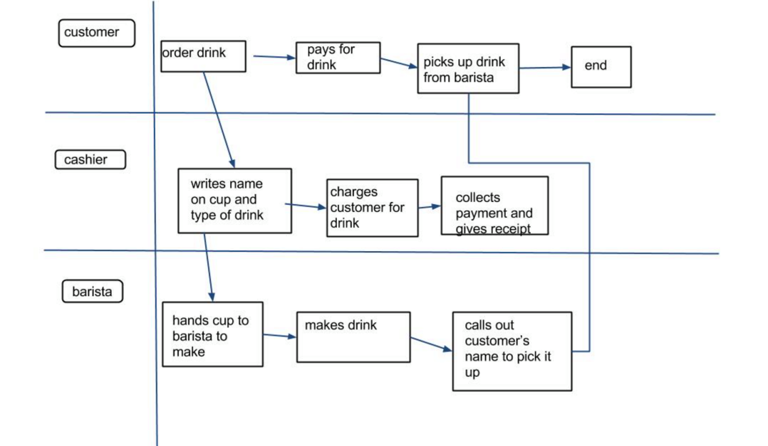
Prototyping is building user interface without adding detail functionality for user to interpret the features of intended software product
Useful document
DOCUMENT ANALYSIS

Slide 16
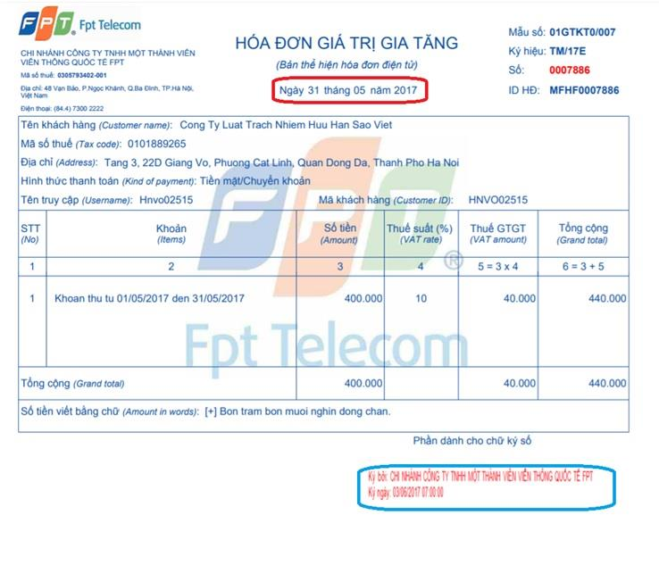
Prototyping is building user interface without adding detail functionality for user to interpret the features of intended software product
Useful document
DOCUMENT ANALYSIS

Slide 17
Prototyping is building user interface without adding detail functionality for user to interpret the features of intended software product
Advantages
Efficient method: Document analysis is less time-consuming and therefore more efficient than other research methods. It requires data selection, instead of data collection.
Availability: Many documents are in the public domain, Internet are obtainable without the authors’ permission
Cost-effectiveness: Document analysis is less costly than other research methods and is often the method of choice when the collection of new data is not feasible.
DOCUMENT ANALYSIS

Slide 18
Prototyping is building user interface without adding detail functionality for user to interpret the features of intended software product
Disadvantages
That the available documents might not be up to date
Requirements might have changed without the specifications being updated
Functionality might be documented that is not needed in a new system.
DOCUMENT ANALYSIS

Slide 19
BRAINSTORMING

Slide 20


Slide 21
PROTOTYPING

Slide 22
Prototyping is building user interface without adding detail functionality for user to interpret the features of intended software product
Defined
Prototyping is building user interface without adding detail functionality for user to interpret the features of intended software product
PROTOTYPING

Slide 23
Prototyping is building user interface without adding detail functionality for user to interpret the features of intended software product
Prototyping
Model
Is used to
CUSTOMER
FEEDBACK
PROTOTYPING
Results into
Used for
DEVELOP/REFINE
PROTOTYPE

Slide 24
Prototyping is building user interface without adding detail functionality for user to interpret the features of intended software product
Used for
The Prototyping Model should be used when the requirements of the product are not clearly understood.
This model can be used for developing user interfaces.
PROTOTYPING

Slide 25
Prototyping is building user interface without adding detail functionality for user to interpret the features of intended software product
Advantages
Quicker user feedback is available leading to better solutions.
Confusing or difficult functions can be identified.
Reduces time and cost as the defects can be detected much earlier.
Missing functionalities can be easily figured out.
Flexibility in design.
PROTOTYPING

Slide 26
Prototyping is building user interface without adding detail functionality for user to interpret the features of intended software product
Disadvantages
Waste time as well as money.
Users may get confused in the prototypes and actual systems.
There may be too much variation in requirements each time the prototype is evaluated by the customer.
It is very difficult for the developers to accommodate all the changes demanded by the customer.
PROTOTYPING

Slide 27
SUMMARY

Slide 28
Prototyping is building user interface without adding detail functionality for user to interpret the features of intended software product
User interface analysis
Document analysis
Brainstorming
Prototyping
SUMMARY

